Slide 1
COEIT Advising Sign Up Project
Daniel Lesko, David Learn, Yadikaer Yasheng

Slide 2
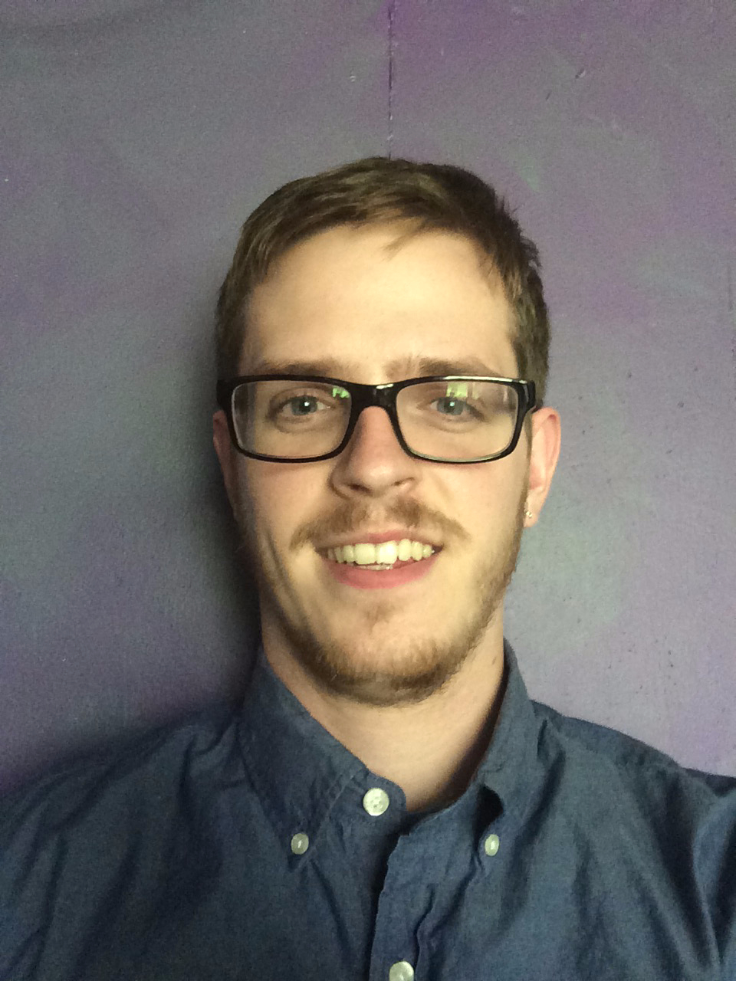
Daniel Lesko Bio
-Rising Junior @ UMBC
-Used to be Graphic Design major
-Took on role as Project Manager
for this project
-24 years old
-Columbia, MD resident

Slide 3
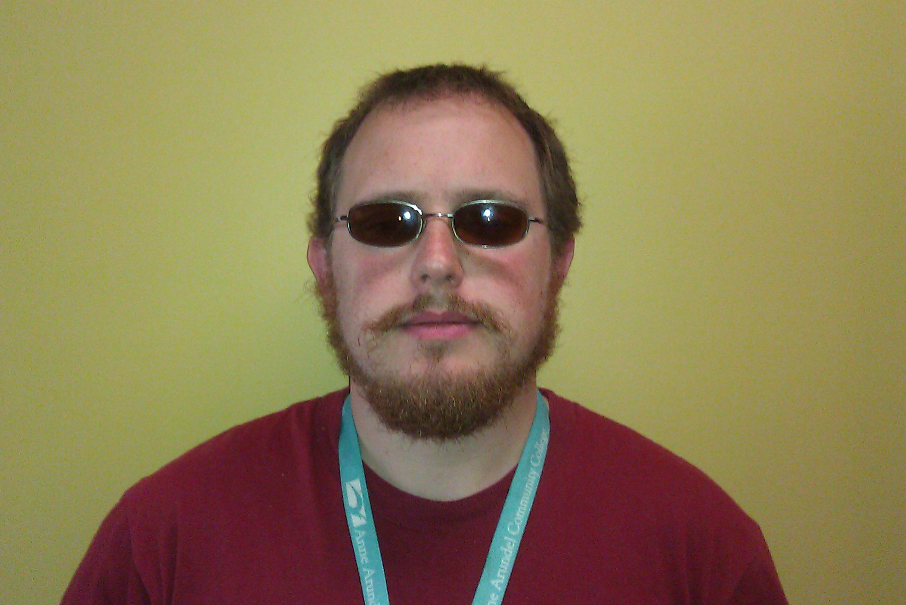
David Learn Bio
-Junior @ UMBC
-Strong Interest in Software Engineering
-Currently employed @ AACC as Lead Technical Assistant for main computer lab.
-Past projects include automated collection of software loadout for lab PCs
-Originally from Pittsburgh.

Slide 4
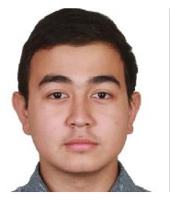
Yadikaer Yasheng Bio
- Sophomore @ UMBC
- Major in CMSC
- Have html/css and Bootstrap experience.
- Game developer
- Have couple games shipped on the mobile market.
- 20 years old
- International Student from China

Slide 5
Project Responsibilities
Daniel Lesko-project manager
Student side development and dreamweaver
David Learn
Advisor side development and testing
Yadikaer Yasheng
CSS, Layout design, general beautification

Slide 6
Demonstration Links
http://youtu.be/ZQSAOILM26k
userpages.umbc.edu/~dale2/CMSC331/Project2

Slide 7
Challenges
-Date and time formating is not friendly
-Overall database table layout was an exercise in agile development
-Learning when to use appropriate javascript elements

Slide 8
Future Implementations
-A tool for advisors rather than admins to rebuild tables for next semester.
-Close all appointments 48 hours before they occur.
-Assign room numbers to appointments.

